Slide 1
DECISION TREES

Slide 2
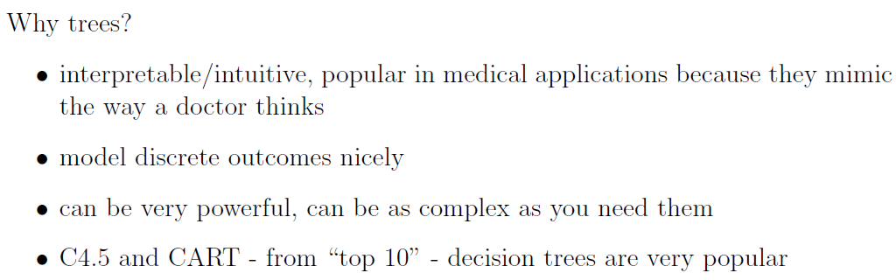

Slide 3
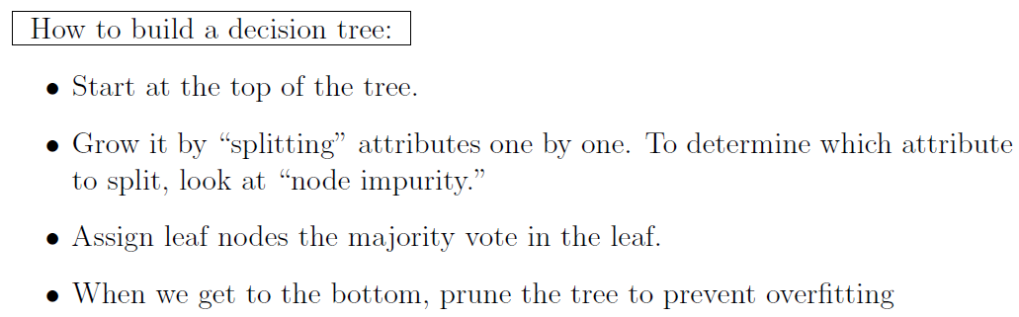

Slide 4
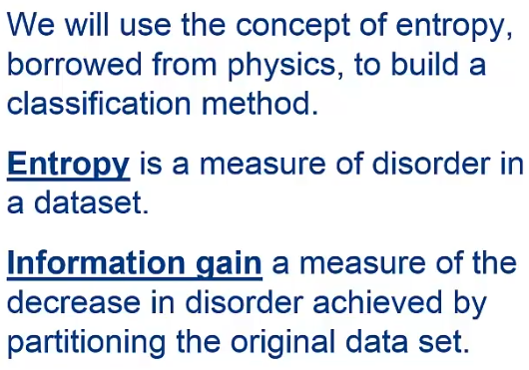

Slide 5
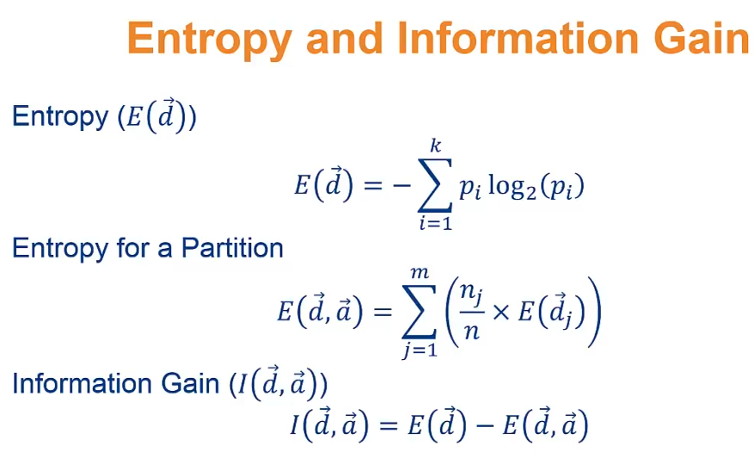

Slide 6
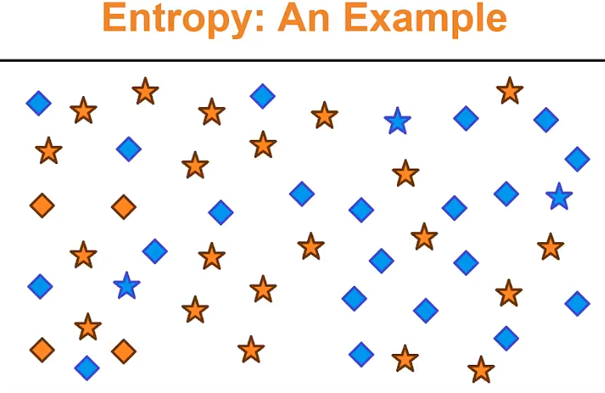

Slide 7
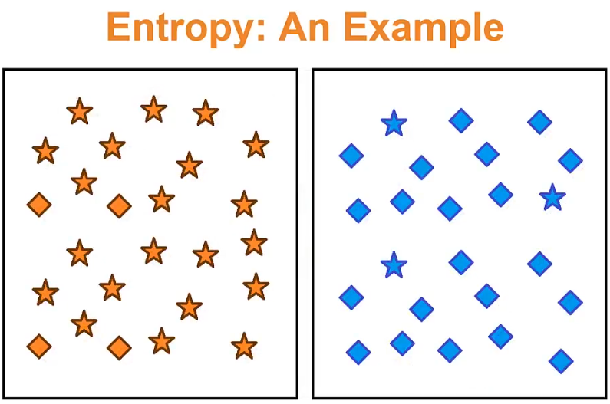

Slide 8
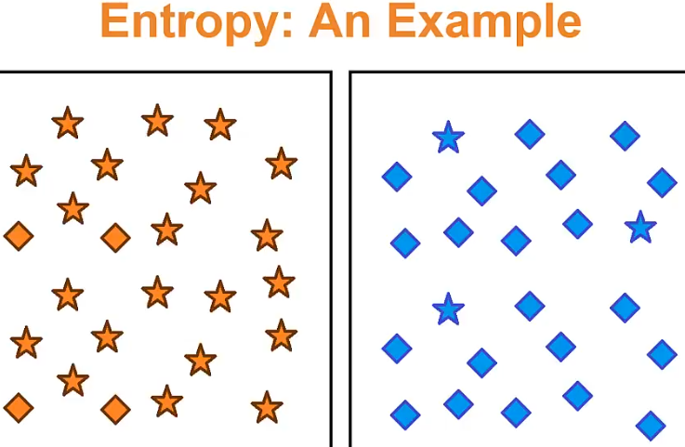

Slide 9
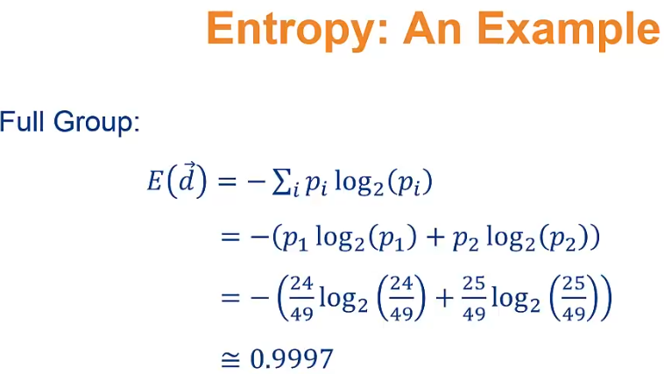

Slide 10
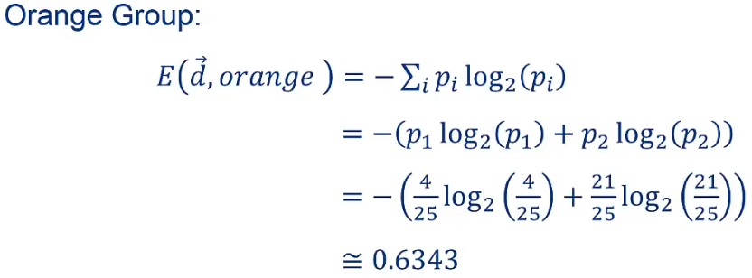

Slide 11
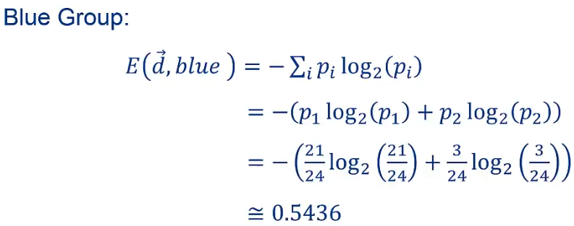

Slide 12
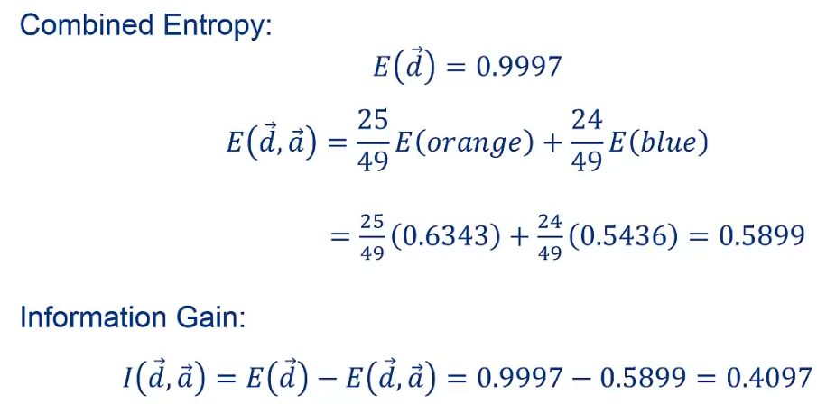

Slide 13
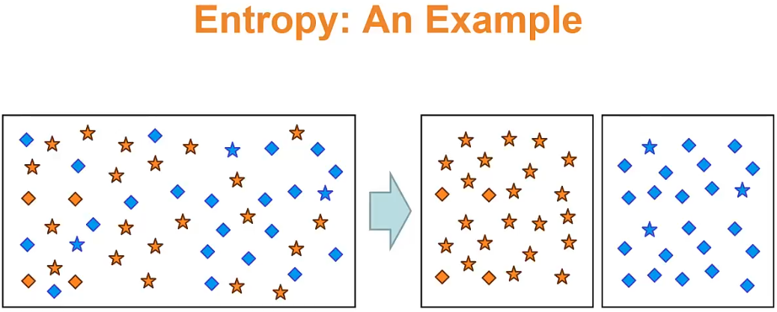

Slide 14
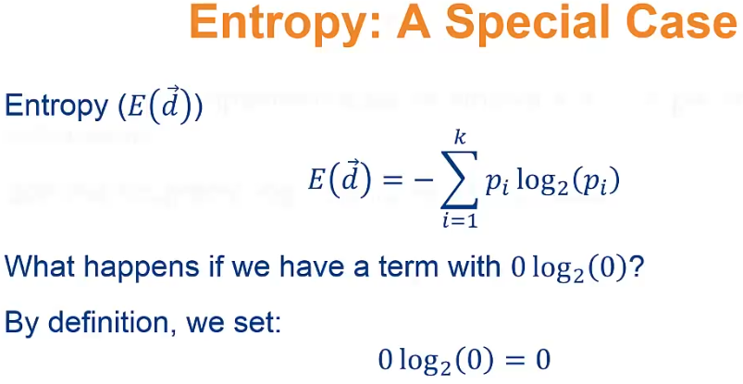

Slide 15
Decision tree induction is the learning of decision trees from class-labeled training tuples.
A decision tree is a flowchart-like tree structure, where each internal node (non-leaf node) denotes a test on an attribute, each branch represents an outcome of the test, and each leaf node (or terminal node) holds a class label.
The topmost node in a tree is the root node.

Slide 16
“How are decision trees used for classification?”
Given a tuple, X, for which the associated class label is unknown, the attribute values of the tuple are tested against the decision tree.
A path is traced from the root to a leaf node, which holds the class prediction for that tuple.
Decision trees can easily be converted to classification rules.

Slide 17
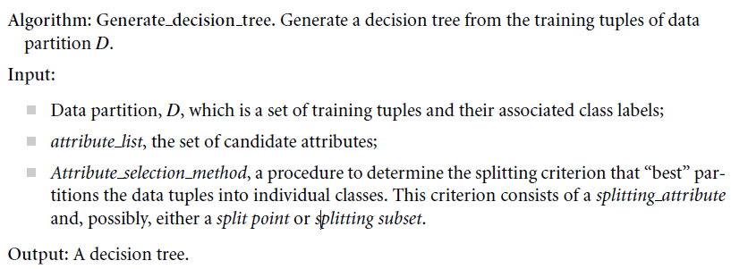

Slide 18
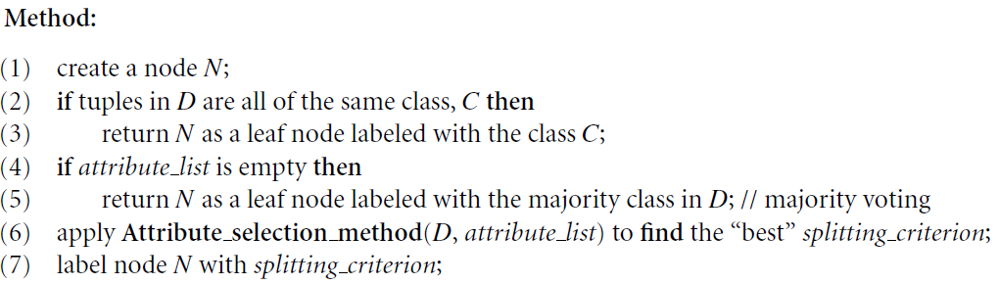

Slide 19
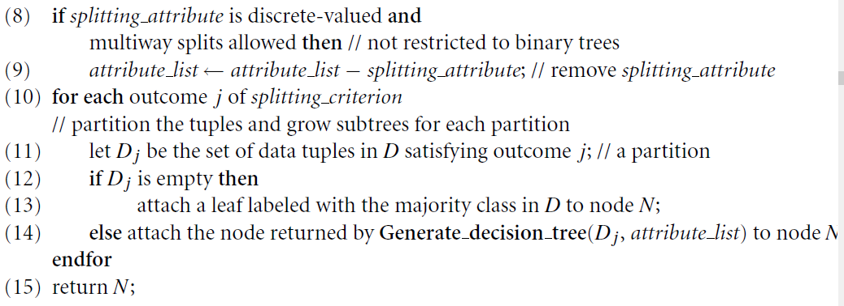

Slide 20
The algorithm starts with a training set of tuples and their associated class labels.
The training set is recursively partitioned into smaller subsets as the tree is being built.
The algorithm is quite straightforward. The strategy is as follows:

Slide 21
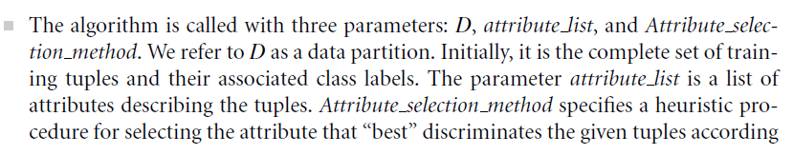
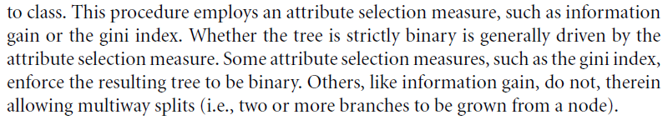

Slide 22
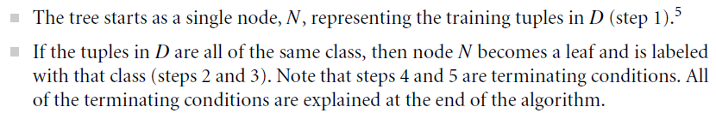

Slide 23
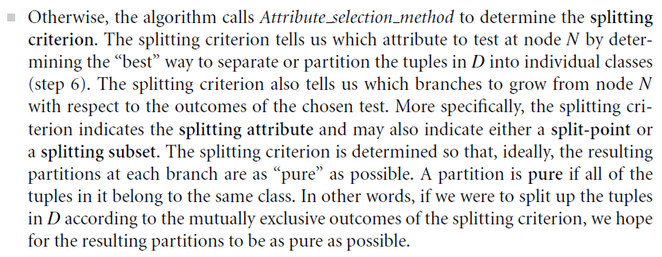

Slide 24
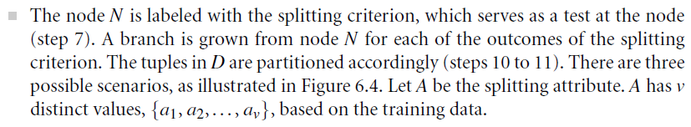

Slide 25
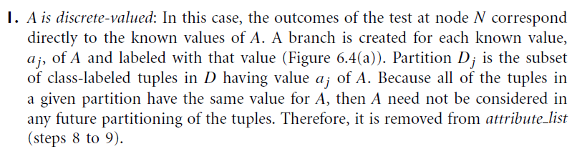

Slide 26
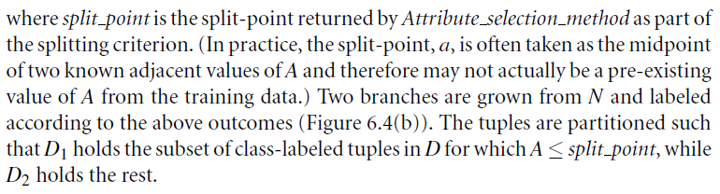

Slide 27
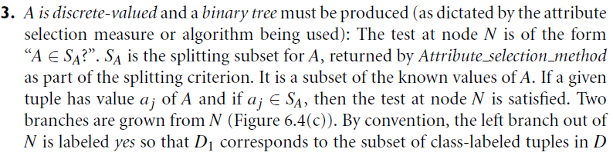

Slide 28
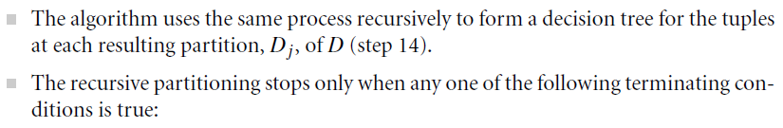

Slide 29
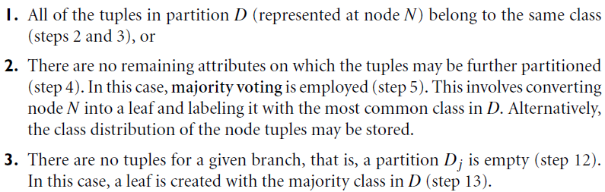

Slide 30
Attribute Selection Measures
An attribute selection measure is a heuristic for selecting the splitting criterion that “best” separates a given data partition, D, of class-labeled training tuples into individual classes.
If we were to split D into smaller partitions according to the outcomes of the splitting criterion, ideally each partition would be pure (i.e., all of the tuples that fall into a given partition would belong to the same class).
Conceptually, the “best” splitting criterion is the one that most closely results in such a scenario.

Slide 31
Attribute selection measures are also known as splitting rules because they determine how the tuples at a given node are to be split.
The attribute selection measure provides a ranking for each attribute describing the given training tuples.
The attribute having the best score for the measure is chosen as the splitting attribute for the given tuples.

Slide 32
If the splitting attribute is continuous-valued or if we are restricted to binary trees then, respectively, either a split point or a splitting subset must also be determined as part of the splitting criterion.
The tree node created for partition D is labeled with the splitting criterion, branches
are grown for each outcome of the criterion, and the tuples are partitioned accordingly.
This section describes three popular attribute selection measures—information gain, gain ratio, and gini index.

Slide 34
The overarching goal and approach in pattern classification is to:
Hypothesize the class of these models,
Process the sensed data to eliminate noise (not due to the models), and
for any sensed pattern choose the model that corresponds best.
Any techniques that further this aim should be in the conceptual toolbox of the designer of pattern recognition systems.

Slide 35
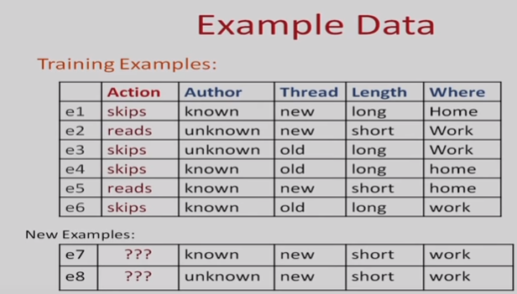

Slide 36
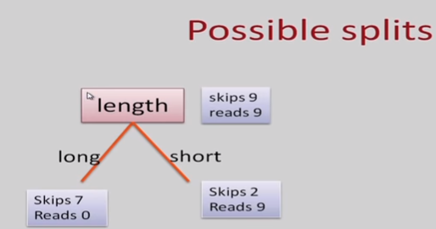

Slide 37
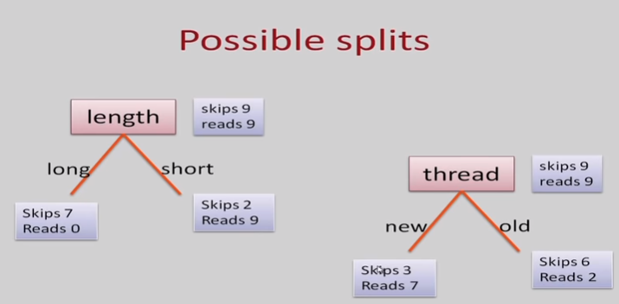

Slide 38
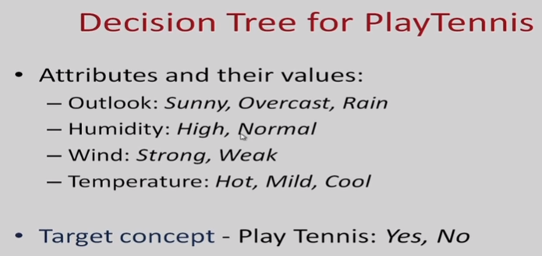

Slide 39
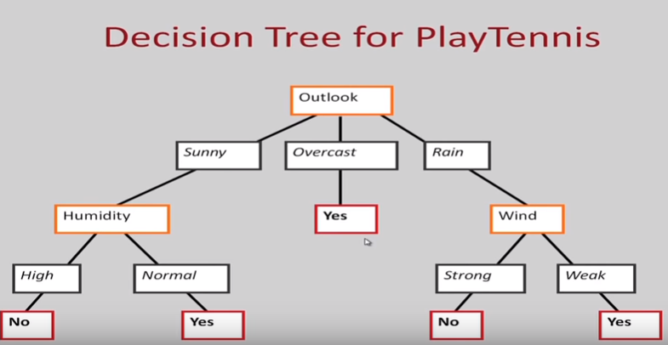

Slide 40
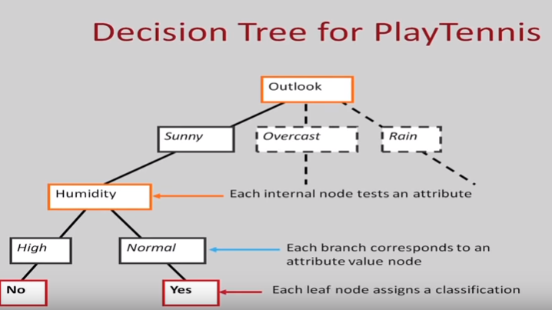

Slide 41
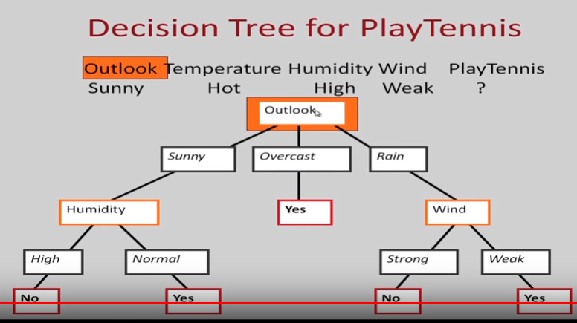

Slide 42
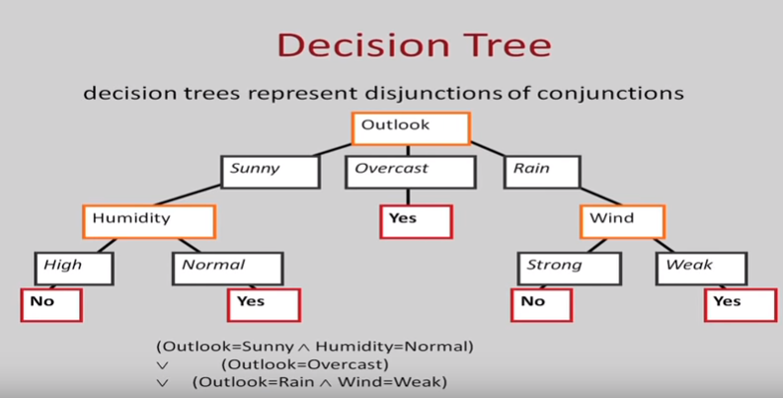

Slide 43
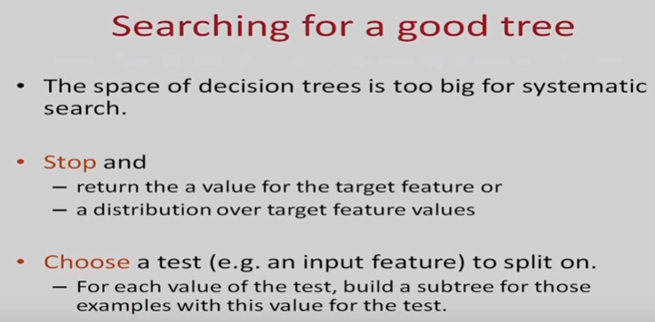

Slide 44
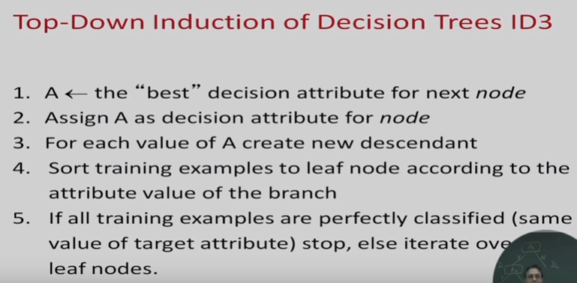

Slide 45
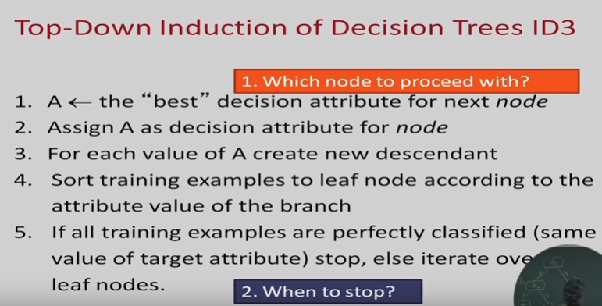

Slide 46
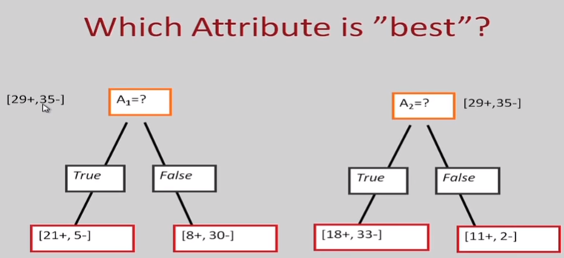

Slide 47
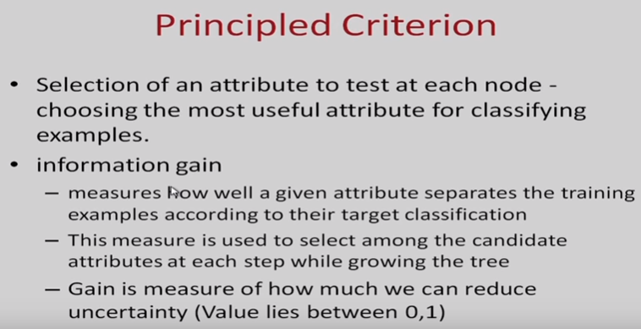

Slide 49
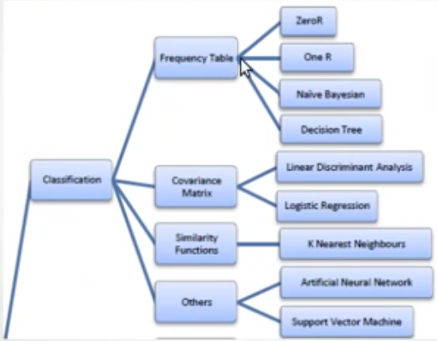

Slide 50
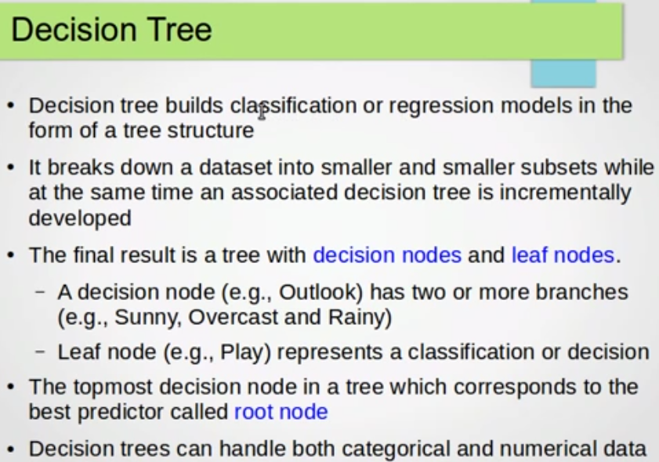

Slide 51
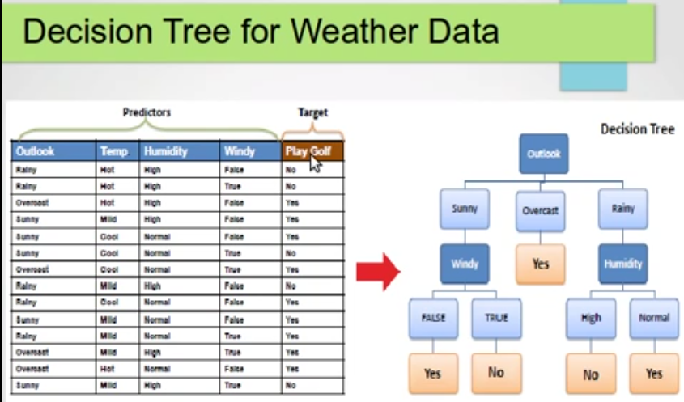

Slide 52
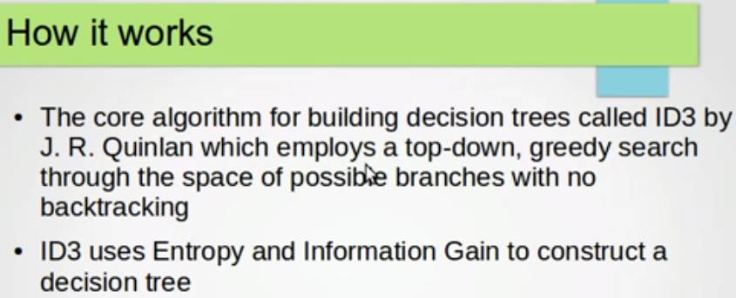

Slide 53
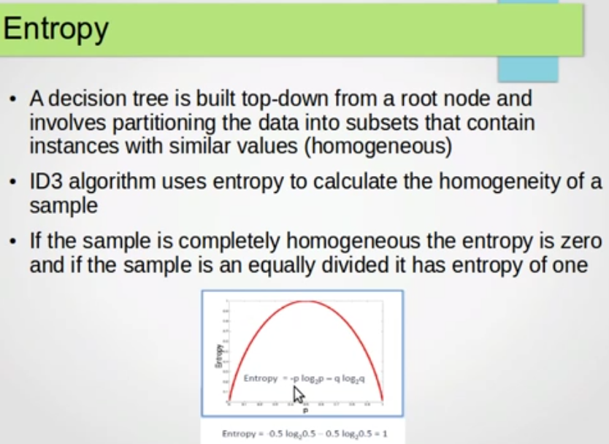

Slide 54
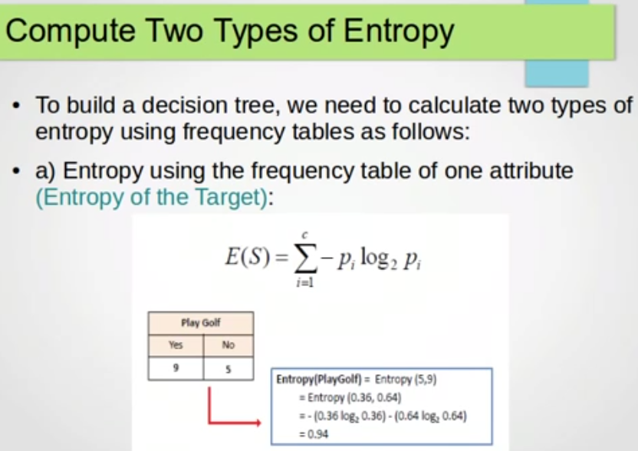

Slide 55


Slide 56
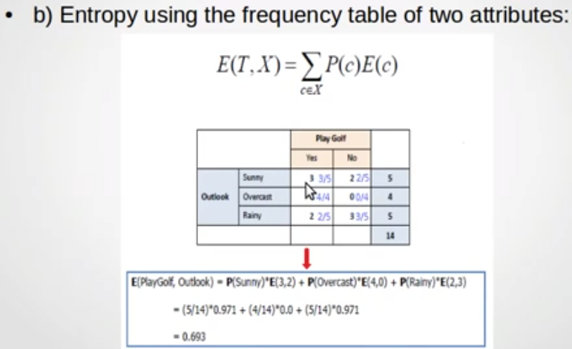

Slide 57
